Slide 1

Final Year Projects: The Design Process

Slide 2
What does it matter? And to whom?
The Product is all that matters? To whom?
The user, the client
The Design? To whom?
The Engineer, Client, and User
A good design increases the longevity of a product.

Slide 3
Design Goals
End
User
Low cost
Increased productivity
Backward compatibility
Traceability of requirements
Rapid development
Flexibility
Functionality
User-friendliness
Usability
Ease of learning
Fault tolerant
Robustness
Runtime
Efficiency
Reliability
Portability
Good documentation
Client
(Customer)
Minimum # of errors
Modifiability, Readability
Reusability, Adaptability
Well-defined interfaces
Developer/
Maintainer

Slide 4
The Project: A Development Life Cycle
Analysis
Design
Implementation
Testing
Maintenance

Slide 5
THE SOFTWARE LIFECYCLE
Requirements Analysis
Define the purpose of the system
Produce a model of the system
Design
Refine the model
System design
Data management strategy
Global control flow
Software architecture

Slide 6
THE SOFTWARE LIFECYCLE
Implementation
Program design
Interface design
Linkage to existing systems
Testing
A number of levels of testing need to be carried out.
Maintenance.
Update and debug software

Slide 7
A Typical Project (adapted from Pressman)
Analysis
Design
Analysis
Design
Analysis
Design
Develop
Test
Evaluate
Analysis
Design
Develop
Test
Evaluate

Slide 8
System Design
Systems design is the specification of a detailed computer-based solution.
Systems analysis emphasizes the business problem.
Systems design emphasizes the technical or implementation concerns of the system.
Notes:
No additional notes

Slide 9
Analysis and Design Models
Analysis:
Focuses on the application domain - the part of an organization for which we are to develop application software.
Nonfunctional requirements define design goals
Functional requirements create functional models through decomposition.

Slide 10
Analysis and Design Models
Design:
Focuses on the solution domain.
Object model - Hardware/Software mapping, Data management (aka static aspects)
Dynamic model – help to identify Concurrency, Global Resource Handling, Software Control (temporal/behavioral aspect)

Slide 11
Typical Design Trade-offs
Functionality v. Usability
Cost v. Robustness
Efficiency v. Portability
Rapid development v. Functionality
Cost v. Reusability
Backward Compatibility v. Readability

Slide 12
Design What?
Prototypes & Models
Software components
Algorithms
Architectures
Files & Databases
Interfaces & Interactions
Hardware & Firmware

Slide 13
Project Report: Design Documentation

Slide 14
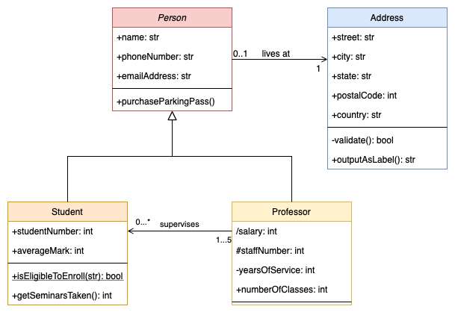
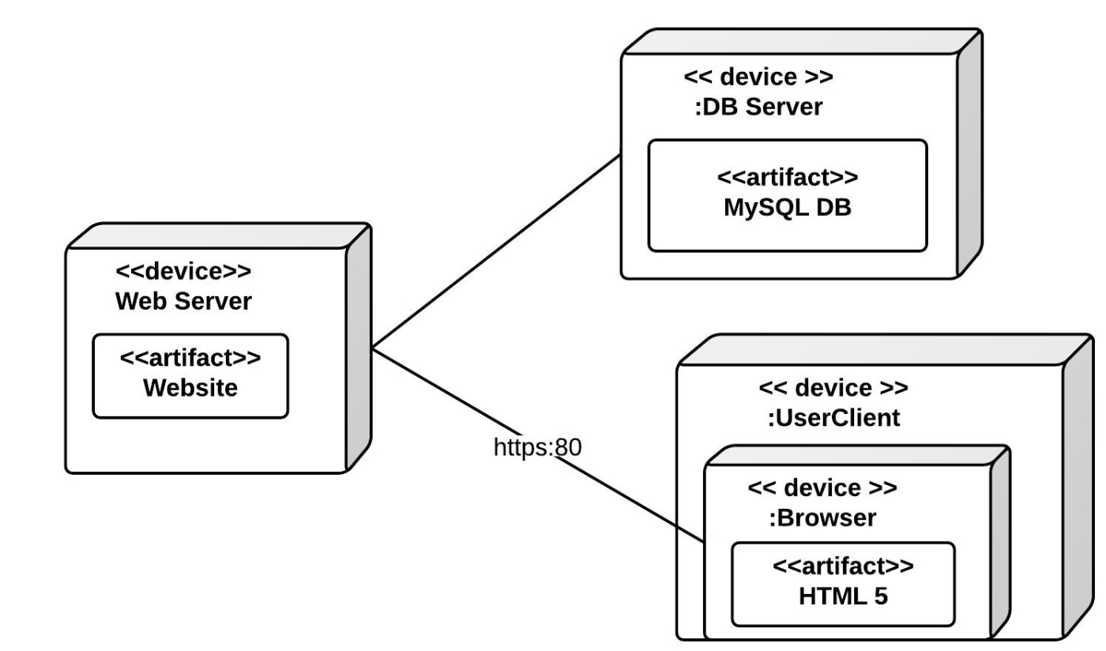
UML
UML diagrams can be useful to describe your artefact’s architecture (Deployment Diagram, Class Diagram)

Slide 15
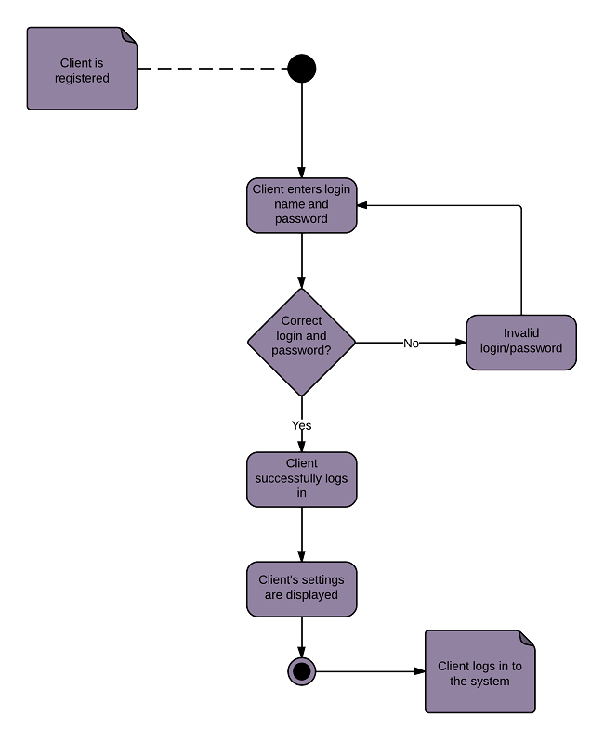
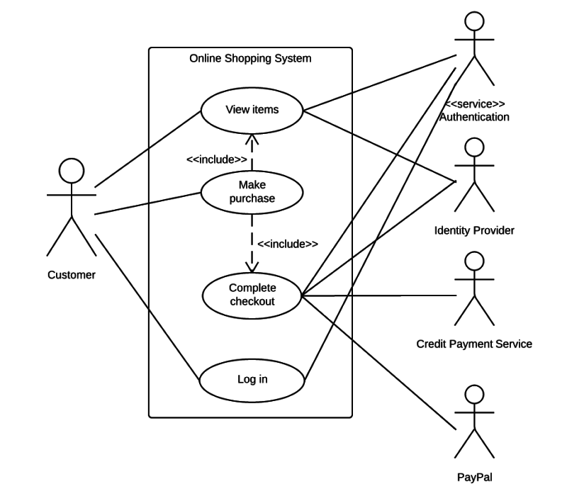
UML
UML can also be useful to describe interactions between the users and your app (e.g., Use Case and Activity diagrams)

Slide 16
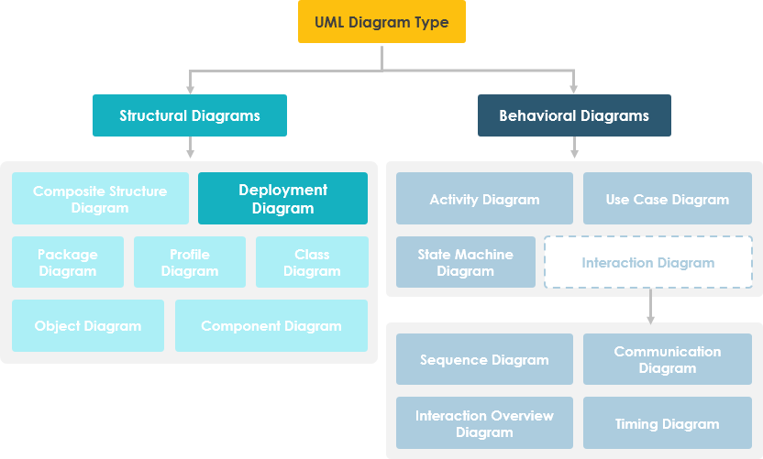
https://www.visual-paradigm.com/guide/uml-unified-modeling-language/what-is-deployment-diagram/

Slide 17
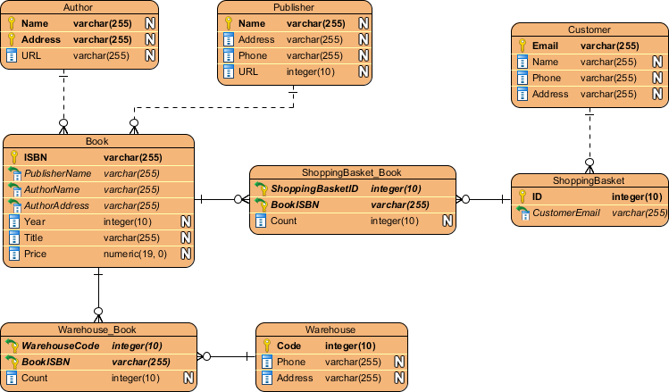
Databases
You should include a diagram of your database or data store, e.g., ERD.

Slide 18
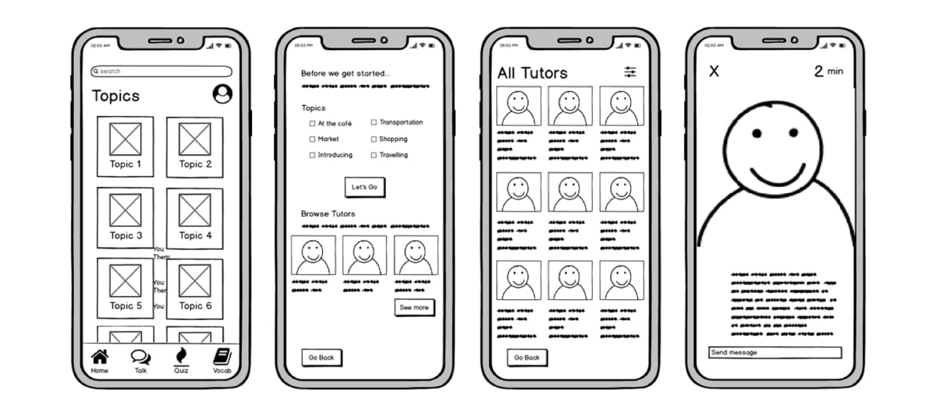
Wireframes
Wireframes and screen mockups should be included.

Slide 19
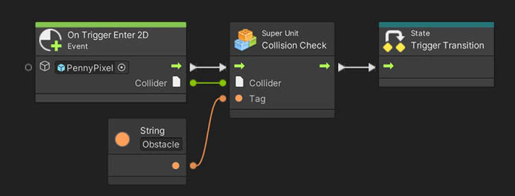
More!
There are many more types of diagrams and tools, depending on the nature of your project (games, cybersecurity, networking etc.)
Please always refer back to your previous modules.
Example: Unity Visual Scripting

Slide 20
Summary
System Design - an essential activity that reduces the gap in comprehension between the problem and its solution.
Design Goals describes the important system qualities
Decomposition an important design technique for reducing the overall system into manageable parts.

